Slide 1
Chapter-2
Applications of Definite Integrals

Slide 2
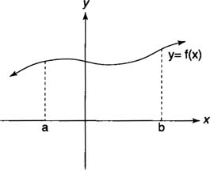
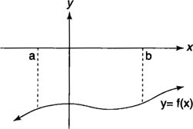
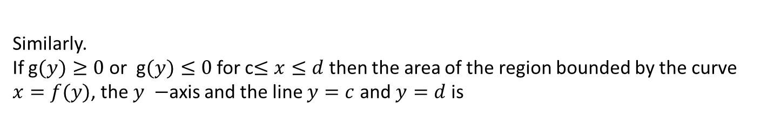
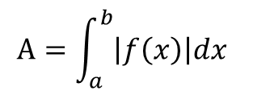

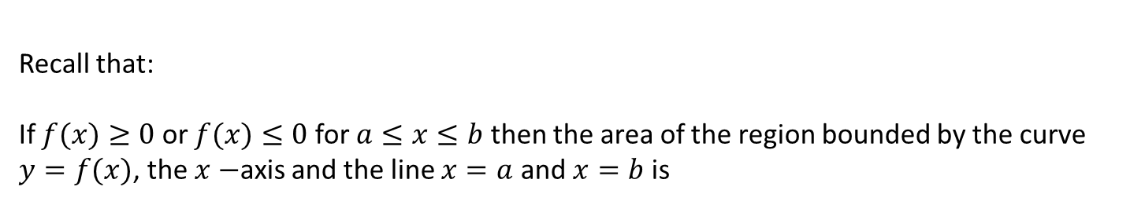

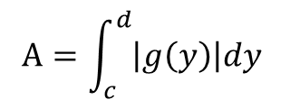
2.1 Area of Regions Between Two Graphs
Definite integrals could be used to determine the area of the region between the graph of a function and the x-axis or the y-axis.
Recall that:
If $f(x)≥0$ or $f(x)≤0$ for $a≤x≤b$ then the area of the region bounded by the curve $y=f(x)$, the $x−$axis and the line $x=a$ and $x=b$ is
$$A=\int_{a}^{b}{\left|f\left(x\right)\right|dx}$$
$f(x)≥0$
$f(x)≤0$
Similarly.
If g$(y)≥0$ or g$(y)≤0$ for c$≤x≤d$ then the area of the region bounded by the curve $x=f(y)$, the $y −$axis and the line $y=c$ and $y=d$ is
$$A=\int_{c}^{d}{\left|g\left(y\right)\right|dy}$$

Slide 3
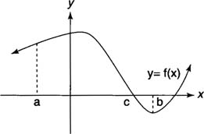
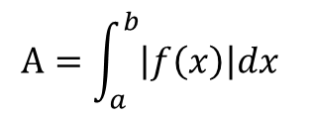
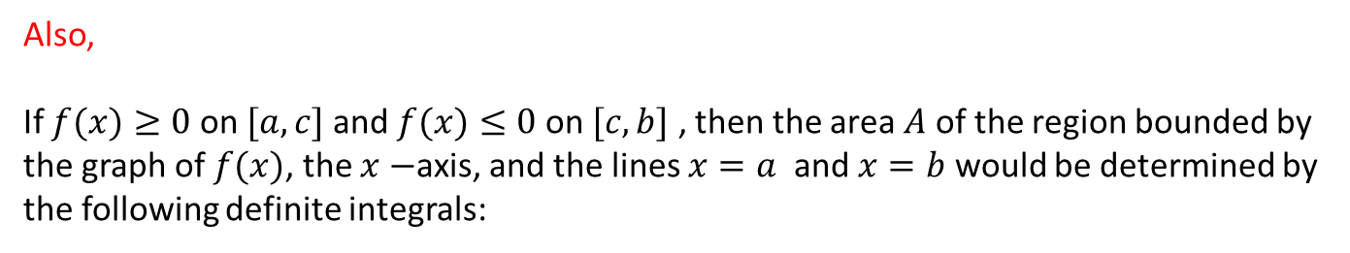
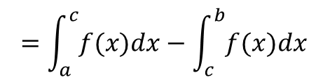
Also,
If $f(x)≥0$ on $[a,c]$ and $f(x)≤0$ on $[c,b]$ , then the area $A$ of the region bounded by the graph of $f(x)$, the $x−$axis, and the lines $x=a$ and $x=b$ would be determined by the following definite integrals:
$$A=\int_{a}^{b}{\left|f\left(x\right)\right|dx}$$
$$=\int_{a}^{c}{f(x)dx}−\int_{c}^{b}{f(x)dx}$$

Slide 4
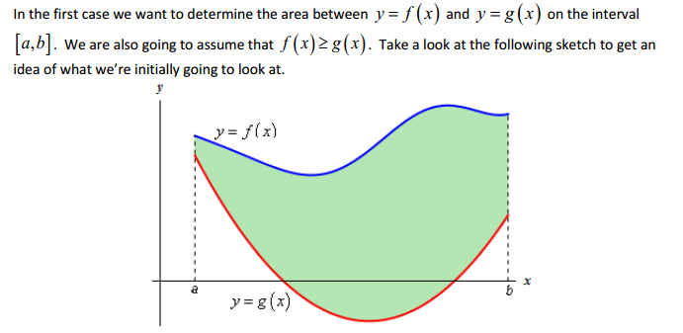

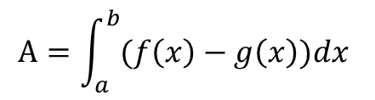
Area Between Two Curves
First Case:
$$A=\int_{a}^{b}{(f\left(x\right)−g\left(x\right))dx}$$
So the Area is,
In other words,

Slide 5
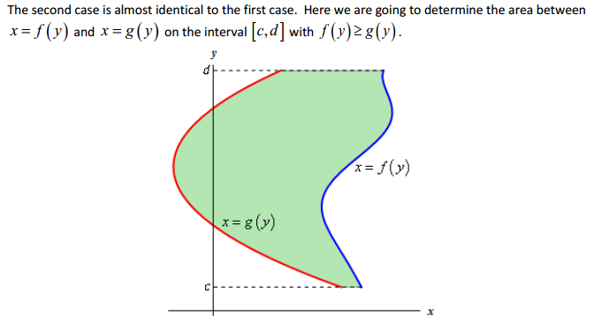

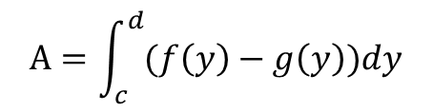
Second Case:
$$A=\int_{c}^{d}{(f\left(y\right)−g\left(y\right))dy}$$
So the Area is,
In other words,

Slide 6
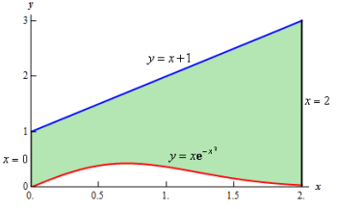
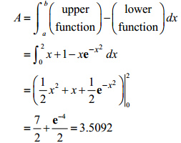
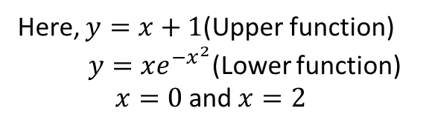
Example set-2.1
1.
Write down the area in integral form and hence evaluate it
(a)
Solution:
So the area is,
Here, $y=x+1$(Upper function)
$y=xe^{−x^{2}}$(Lower function)
$x=0$and $x=2$

Slide 7
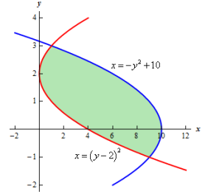
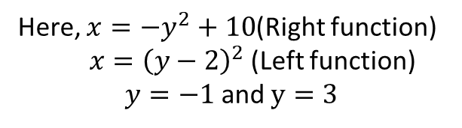
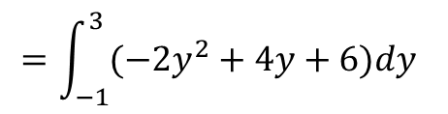
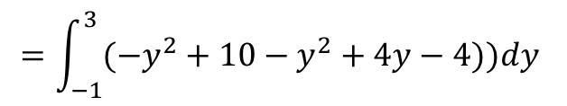
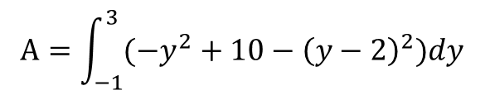
Example set-2.1
(b)
So the area is,
Solution:
$$A=\int_{−1}^{3}{(−y^{2}+10−{\left(y−2\right)}^{2})dy}$$
Here, $x=−y^{2}+10$(Right function)
$x={\left(y−2\right)}^{2}$(Left function)
$y=−1$and $y=3$
$$=\int_{−1}^{3}{(−y^{2}+10−y^{2}+4y−4))dy}$$
$$=\int_{−1}^{3}{(−{2y}^{2}+4y+6)dy}$$
?

Slide 8
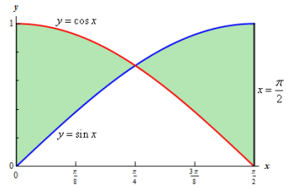
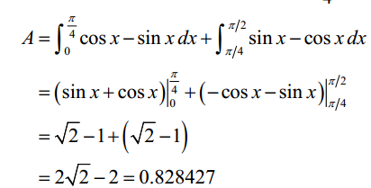
Example set-2.1
(c)
Solution:
The area is,

Slide 9
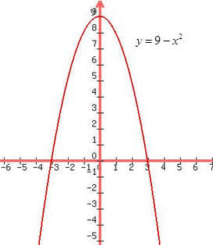
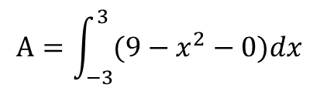





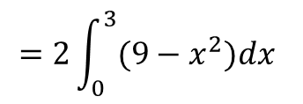
Example set-2.1
2.
Sketch the region enclosed by $y=9−x^{2}$ and the $x−$axis. Hence find its area.
Solution: The region is shown in the Figure given below,
$y=9−x^{2}$, $y=0$($x −$axis)
$$9−x^{2}=0$$
$$x^{2}=9$$
$$∴x=±3$$
So the area is,
$$A=\int_{−3}^{3}{(9−x^{2}−0)dx}$$
$$=2\int_{0}^{3}{(9−x^{2})dx}$$
$$=36$$

Slide 10
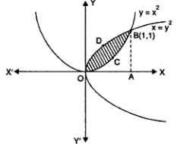
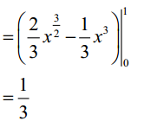


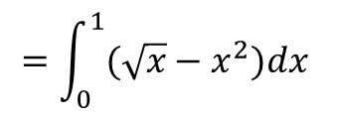




Example set-2.1
3.
Sketch the region enclosed by the parabolas $y=x^{2}$ and $x=y^{2}$. Hence find its area.
Solution: The region is shown in the Figure given below,
$y=x^{2}$, $x=y^{2}$
$y=x^{2}$, $y=\sqrt{x}$
$$x^{2}=\sqrt{x}$$
$$x^{4}=x$$
${x(x}^{3}−1)=$0
$$∴x=0,1$$
So the area is,
$$=\int_{0}^{1}{(\sqrt{x}−x^{2})dx}$$

Slide 11
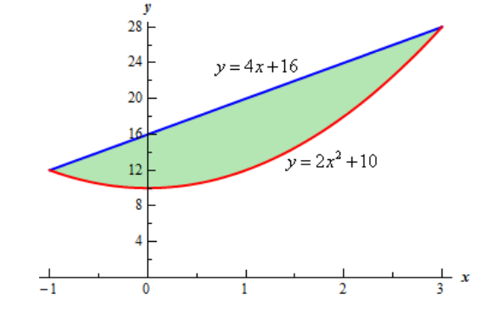
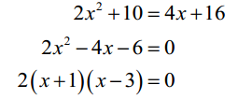
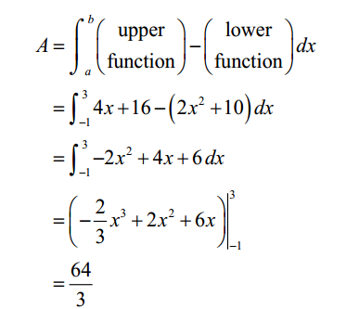


Example set-2.1
4.
Sketch the region enclosed by the parabolas $y={2x}^{2}+10$ and $y=4x+16.$ Hence find its area.
Solution: The region is shown in the Figure given below,
$y={2x}^{2}+10$ , $y=4x+16$
$$∴x=−1,3$$
So the area is,

Slide 12
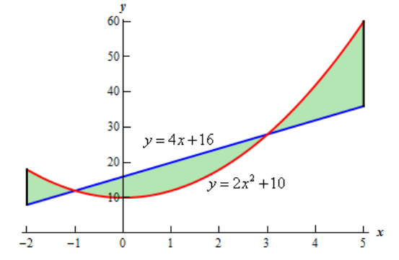
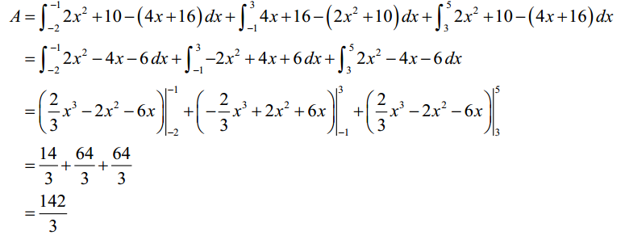
Example set-2.1
5.
Sketch the region enclosed by the parabolas $y={2x}^{2}+10$ and $y=4x+16,$
$x=−2$ and $x=5$Hence find its area.
Solution: The region is shown in the Figure given below,
$y={2x}^{2}+10$ , $y=4x+16$
$$∴x=−1,3$$
So the area is,

Slide 13
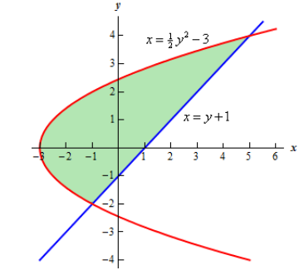
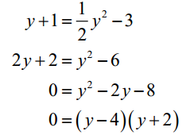
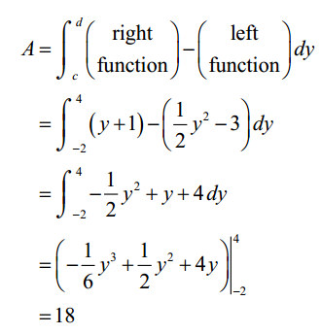



Example set-2.1
6.
Determine the area enclosed by $x=\frac{1}{2}y^{2}−3$ and $y=x−1$
Solution:
$x=\frac{1}{2}y^{2}−3$ and $y=x−1$
So,
$x=\frac{1}{2}y^{2}−3$ and $x=y+1$
So the area is,
$$∴y=−2,4$$

Slide 14
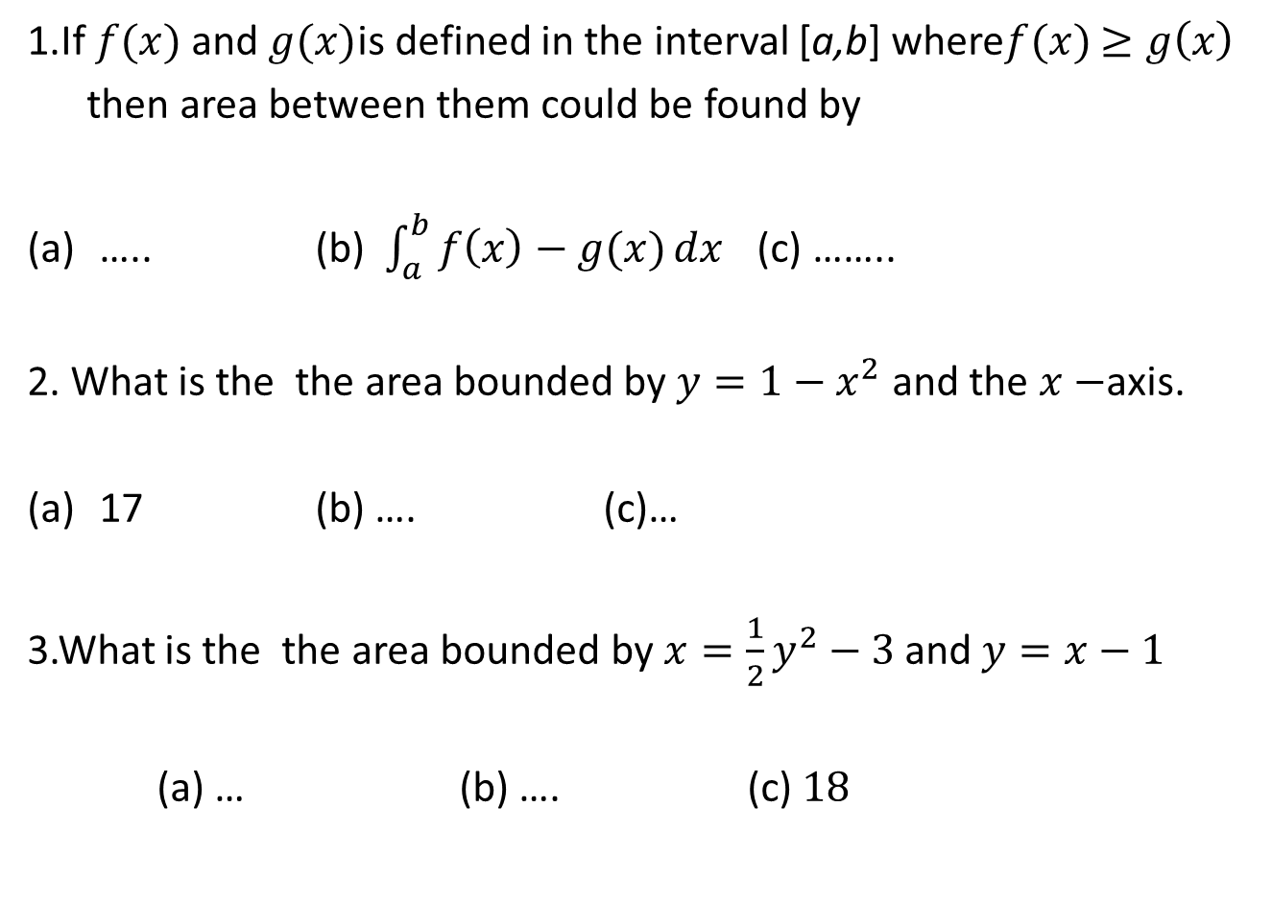
Sample MCQ
1.If $f(x)$ and $g(x)$is defined in the interval [a,b] where$f(x)$ $≥g\left(x\right)$
then area between them could be found by
….. (b) $\int_{a}^{b}{f\left(x\right)−g(x)}dx$ (c) ……..
2. What is the the area bounded by $y=1−x^{2}$ and the $x−$axis.
17 (b) …. (c)…
3.What is the the area bounded by$x=\frac{1}{2}y^{2}−3$ and $y=x−1$
(a) … (b) …. (c) $18$

Slide 15
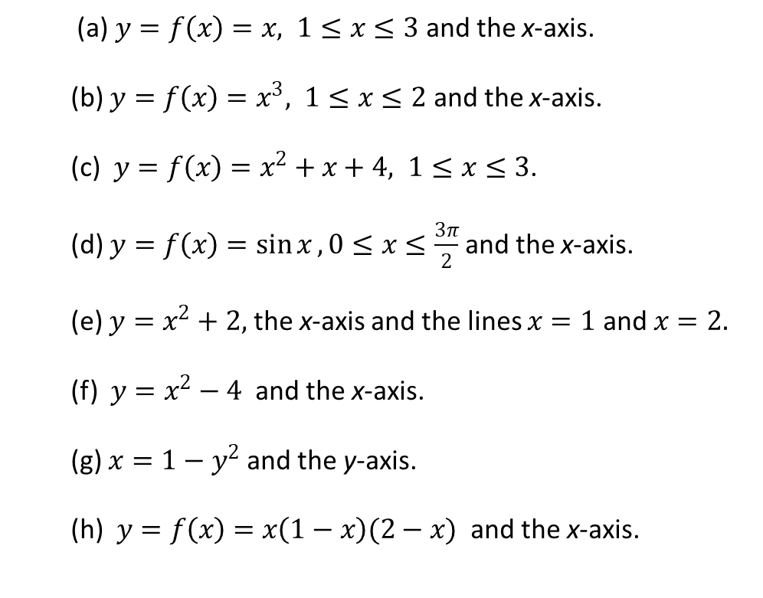
Exercise set-2.1
1.
Sketch the region enclosed by the following curves and then find its area.
(a) $y=f\left(x\right)=x, 1≤x≤3$ and the x-axis.
(b) $y=f\left(x\right)=x^{3}, 1≤x≤2$ and the x-axis.
(c) $y=f\left(x\right)=x^{2}+x+4, 1≤x≤3$.
(d) $y=f\left(x\right)=\sin{x},0≤x≤\frac{3π}{2}$ and the x-axis.
(e) $y=x^{2}+2,$the x-axis and the lines $x=1$ and $x=2.$
(f) $y=x^{2}−4$and the x-axis.
(g) $x=1−y^{2}$ and the y-axis.
(h) $y=f\left(x\right)=x\left(1−x\right)(2−x)$ and the x-axis.
.

Slide 16
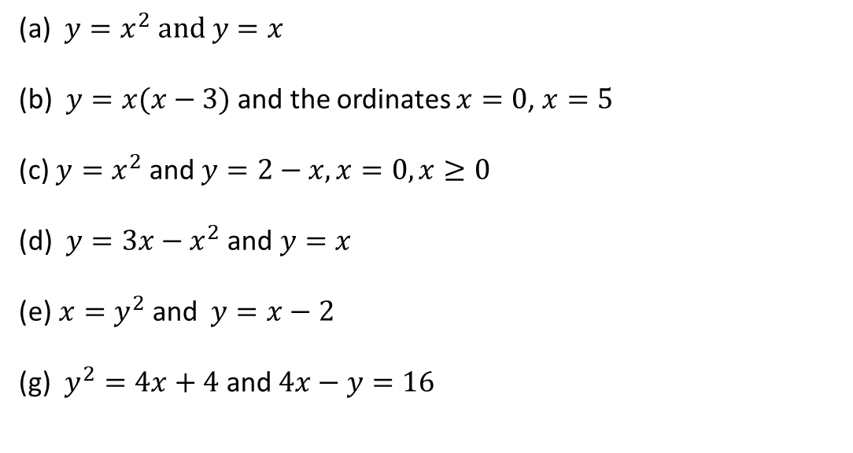
2.
Sketch the region enclosed by the following curves and then find its area.
(a) $y=x^{2} and y=x$
(b) $y=x(x−3)$ and the ordinates $x=0$, $x=5$
(c) $y=x^{2} \text{and} y=2−x, x=0,x≥0$
(d) $y=3x−x^{2}$ and $y=x$
(e)$x=y^{2} \text{and} y=x−2$
(g) $y^{2}=4x+4$ and $4x−y=16$
.
3.
Calculus– James Stewart - 8th edition
P- 434 Ex # 1, 3, 5 – 9, 13, 14, 17, 18, 22

Slide 17
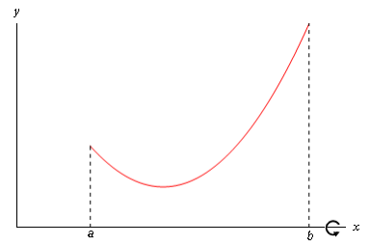
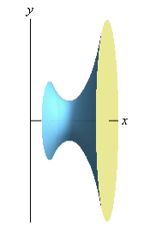
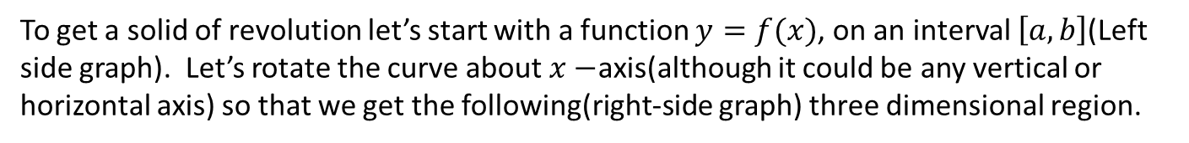
2.2 Volumes of Solids of Revolution
What is Solids of Revolution
If a region is rotated completely (i.e. through 2π radians) about a straight line, the solid formed is a solid of revolution. Any cross section perpendicular to the axis of rotation is circular.
To get a solid of revolution let’s start with a function $y=f(x)$, on an interval $\left[a,b\right]$(Left side graph). Let’s rotate the curve about $x−$axis(although it could be any vertical or horizontal axis) so that we get the following(right-side graph) three dimensional region.
Now we are going to find the volume of the object

Slide 18
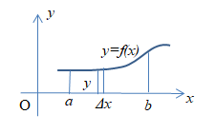
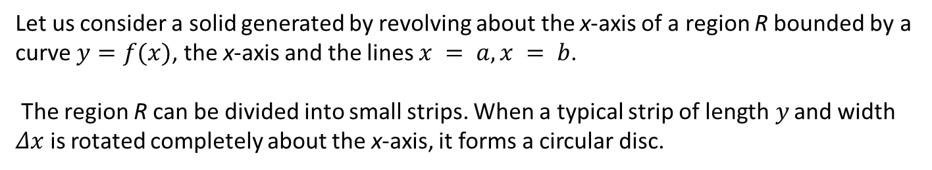
Volume of Solids of Revolution
Let us consider a solid generated by revolving about the x-axis of a region R bounded by a curve $y=f(x)$, the x-axis and the lines $x = a, x = b$.
The region R can be divided into small strips. When a typical strip of length$y$ and width $Δx$ is rotated completely about the x-axis, it forms a circular disc.

Slide 19

Volume of Solids of Revolution
The volume $ΔV$ of the disc is ,
The volume of the solid can be divided into small discs. Summing all the discs as $∆x→0$we have the volume of revolution $V_{x}$, about the $x−$axis
In the same way, when a region bounded by the curve $x=f(y)$, , the y-axis and the lines $y =c, y =d$is rotated about the y-axis, the solid formed has volume
This method is often called method of disks or the method of rings

Slide 20
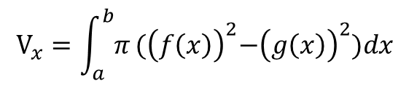
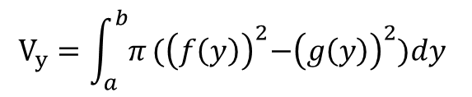
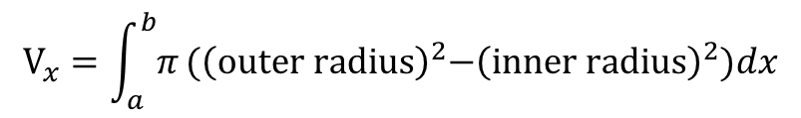
Volume of Solids of Revolution
If we have two function $y=f(x)$ and $y=g(x)$ where $f(x)>g(x)$ and bounded by $x=a,x=b$ then volume solid of revolution is about $x−$axis is given by
$$V_{x}=\int_{a}^{b}{π}{(\left(f\left(x\right)\right)}^{2}−{\left(g\left(x\right)\right)}^{2})dx$$
$$V_{x}=\int_{a}^{b}{π}{(\left(outer radius\right)}^{2}−{\left(inner radius\right)}^{2})dx$$
Similarly for the volume of solid of revolution about y-axis is,
$$V_{y}=\int_{a}^{b}{π}{(\left(f\left(y\right)\right)}^{2}−{\left(g\left(y\right)\right)}^{2})dy$$

Slide 21
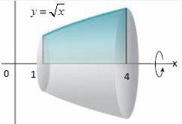
Example set-2.2.1
1.
Find the volume of the solid that is obtained when the region under the curve $y=\sqrt{x}$ over the interval $[1,4]$ is revolved about the x-axis.
Solution:
The volume is ,

Slide 22



2.
Find the volume of the solid that is obtained when the region under the curve $y=\sqrt[3]{x}$ and $y=\frac{x}{4}$ that lies in the first quadrant and is revolved about the y-axis.
Solution:
So, the volume is ,

Slide 23

Sample MCQ
1.If we have two function $y=f(x)$ and $y=g(x)$ where $f(x)>g(x)$ and bounded by $x=a,x=b$ then volume solid of revolution is about $x−$axis is given by
….. (b) $\int_{a}^{b}{π}{(\left(f\left(x\right)\right)}^{2}−{\left(g\left(x\right)\right)}^{2})dx$ (c) ……..
2. Find the volume of the solid that is obtained when the region under the curve $y=\sqrt{x}$ over the interval $[1,4]$ is revolved about the x-axis.
$\frac{15π}{2}$ (b) …. (c)…
3.Find the volume of the solid that is obtained when the region under the curve $y=\sqrt[3]{x}$ and $y=\frac{x}{4}$ that lies in the first quadrant and is revolved about the y-axis.
(a) … (b) …. (c)$\frac{512π}{21}$

Slide 24



Exercise set-2.2.1
1.
Find the volume of the solid that results when the shaded region is revolved about the indicated axis:
(a)
(b)
(c)

Slide 25


2.
Find the volume of the solid when the region enclosed by the given curves is revolved about the x-axis.
(a) $y=\sqrt{x}, x=9$.
(b) $y=x^{2}, x=0, x=2$.
(c) $y=x^{2}−4x+5, x=1, x=4.$
(d) $y=x, y=1, x=0$.
3.
Find the volume of the solid when the region enclosed by the given curves is revolved about the y-axis.
(a) $y=\sqrt{x}, x=0, y=3.$
(b) $x=1−y^{2}, x=0$.
(c) $y=\frac{1}{x}, y=1, y=2.$
4.
Calculus– James Stewart - 8th edition
P- 446 Ex # 1-10

